Slide 1

Feeding Westchester
FY25 HPNAP Food and Operational Support Training
Reporting Period – July 1, 2024 – June 30, 2025
Training Dates:
3/27/2024 and 4/1/2024
Grant Application Submission Timeline: 3/25/2024 - 4/22/2024 5PM
1

Slide 2
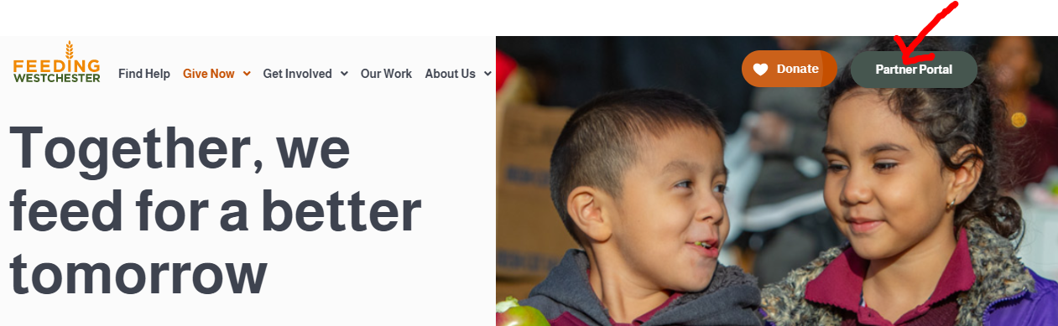
What is HPNAP? Hunger Prevention and Nutrition Assistance Program
HPNAP is a New York State funded grant program that provides lines of credit to be used to purchase HPNAP approved nutritious food items from Feeding Westchester’s Inventory. It also provides funding for Operations Support.
There are 10 Food Banks in New York State that administer the HPNAP Grant Program.
HPNAP grant funds are designed to supplement and/or match a program’s own efforts. Funds should not be viewed as a sole means of support.
How do I access the online HPNAP FY25 Application?
  The application is available in the Partner Portal. Go to www.feedingwestchester.org to access and select Partner Portal to access the link. The link is also available on the Message Board in the Shopping Portal.
  A PDF copy of the application will be provided to use as a guide only if needed on request. Handwritten copies will not be accepted and will be disqualified from the review process.

Slide 3
HPNAP Purchased Food Grant
The HPNAP Food Grant provides eligible food pantries, soup kitchens, and emergency shelters with lines of credit. Funds are used to purchase HPNAP eligible products from Feeding Westchester Inventory of Items – think of the grant funds as a spenddown!
Feeding Westchester Partners who are HPNAP eligible may apply for a Purchased Food Line of Credit up to $8,000 per Fiscal Year (July 1 – June 30th).
If your organization operates two programs such as a food pantry and a meal program, you must complete an application for each.
If awarded funding, your grant will be active at the beginning of the Fiscal Year on July 1, 2024 – June 30, 2025
Grant Management is a part of ensuring your funds are spent timely. Grant balances are available in the agency shopping portal. It is an expectation of Feeding Westchester that you manage your grant effectively and timely.

Slide 4
HPNAP Green Thumb Program
The purpose of the Green Thumb Program is to provide and distribute fresh produce, as well as provide nutrition education to the community members through our HPNAP eligible food partners. The goal is to reach the population who would not usually have access to fresh and nutritious produce.
The Green Thumb Program provides eligible partners with once monthly produce bags, between 11-14 lbs. of fresh items such as carrots, potatoes, blueberries, lettuce, pears, oranges, etc...
Feeding Westchester purchases these items weekly from the Hunt's Point Market every Monday (unless there is a holiday, then we go on a Tuesday). There will be no deliveries on the day we go to market. Items are Grade A fruits and vegetables. Please note: if you are an agency that receives GT on a Tuesday, there will be no delivery the day after a Monday holiday and your GT will not be rescheduled for later in the week as in prior years. Please review your calendar carefully for these exceptions.
If applying for Green Thumb, agencies must select their first and second choice which must fall on their regular scheduled delivery date. Please reach out to Monique Marshall at MMarshall@feedingwestchester.org to discuss alternative schedules if necessary. NOTE: If you are an agency that receives a Monday delivery (Yonkers), you must select two other preferred dates. Only one date will be selected by Feeding Westchester for pick up or delivery.

Slide 5
HPNAP FY24 Operations Support
Operations Support (OS) grants are a part of HPNAP funding which provide non-food support to eligible emergency food relief organizations (EFROs), for items such as staff, utilities, space, disposables and food service (Capital) equipment. Grants are awarded on a competitive basis. The amount of an OS grant award is limited and is variable, based on annual State budget appropriations. Submission of an application does not guarantee receipt of an award. Agencies should not include Operations Support funds as part of their annual budget.
If approved for OS, agencies are required to sign an Operation Support Agreement and to provide Feeding Westchester with proof of expenditures. Failure to do so, will result in agency suspension and possible of denial of future OS funding. Please note agency will be required to return unspent funds to Feeding Westchester.
Operation Support checks must be cashed by your agency within 30 days of receipt of funds. Please ensure your organization earmark these funds as operation support so you can keep track of expenditures for awarded categories.

Slide 6

Operational Support Basics
Operations Support (OS) grants provide non-food support to eligible emergency food programs (EFPs)
OS provides funding to agencies currently providing emergency food to food insecure New Yorkers
OS funding is to supplement
Funds may not be used as start-up costs for new activities/staff positions
Notes:
Operations Support is provided by the Hunger Prevention & Nutrition Assistance program through New York State. Operational support provided non-food support to eligible emergency food programs (known as EFP’s). EFPS must be currently providing emergency food to food insecure New Yorkers as OS funding cannot be used for start-up costs for new activities or staff positions. In addition, OS support is meant to supplement and agencies should not solely rely on this funding in their budget.

Slide 7
Six Expenditure Categories
Staff
Utilities
Space
Food Service Paper Products and Other Supplies (Disposables)
Transportation
Food Service (Capital) Equipment
NOTE: You may choose 2 out of the 5 categories totaling $6,000 or less, OR you may submit for 3 categories if the 3rd category is for Equipment. If this is the case, the total amount requested may be increased to $8,000.
Notes:
Agencies may receive funding for any of the six categories – Staffing, Utility costs, Space, Food Service Disposables, Transportation, and Food Service Capital Equipment. These are the six categories agencies may choose from during the grant application process.

Slide 8

Staff
Only direct services workers may be funded
  This includes persons actually engaged in the serving or storing of food
    Ex. Cooks, kitchen help, pantry volunteers, and food service or storage area cleanup persons, etc.
    Administrative personnel such as bookkeepers and directors or non-food workers such as maintenance workers are not fundable.
Notes:
Staff costs may only be used for direct services workers who engage in the serving or storing of food. These employees or volunteers may be cooks, kitchen help, pantry volunteers, and food service or storage area cleanup persons.
Administrative personnel such as bookkeepers and directors or non-food workers such as maintenance workers are not fundable.

Slide 9



2. Utilities
Food Service work or storage area utility costs such as:
  Heat
  Water
  Electricity
  Trash and recycling removal, pest control services, and sewer charges as well as telephone costs and costs associated with other than food service or storage areas are not fundable.
Notes:
Food service work or storage area utility costs such as heat, water, electricity may be funded. Trash and recycling removal, pest control services, and sewer charges as well as telephone costs and costs associated with other than food service or storage areas are not fundable.

Slide 10

3. Space
Costs for currently occupied space for direct emergency food service or storage areas may be funded
  Rent or user fees
  Costs for administrative offices and mortgage payments are not fundable.
Notes:
Costs for currently occupied space for direct emergency food service or storage areas may be funded. Costs for administrative offices are not fundable. OS may fund rent or user fees, but may not be used to pay mortgage payments or any payment in excess of actual charges to the EFP.

Slide 11

4. Food Service Paper Products and
Other Supplies (Disposables)
Non-durable/disposable supplies necessary to the provision of emergency food may be funded
  Paper/plastic bags
  Disposable plates
  Cups and dinnerware
  Plastic wrap
  Aluminum foil
  Cardboard boxes
  Food containers
Supplies that are not necessary to the provision of food, such as office supplies, toilet paper and cleaning materials are not fundable.
Notes:
Non-durable/disposable supplies necessary to the provision of emergency food may be funded. This includes, but is not limited to paper/plastic bags, disposable plates, cups, and dinnerware, plastic wrap, aluminum foil, cardboard boxes, and food containers. Some durable non-disposable items may also be funded. Items must be necessary for the provision, safe handling, and safe transport of emergency food. Requests for non-durable items must include a written specific justification for the need of such items. Supplies that are not necessary to the provision of food such as office supplies, toilet paper and cleaning materials are not fundable.

Slide 12
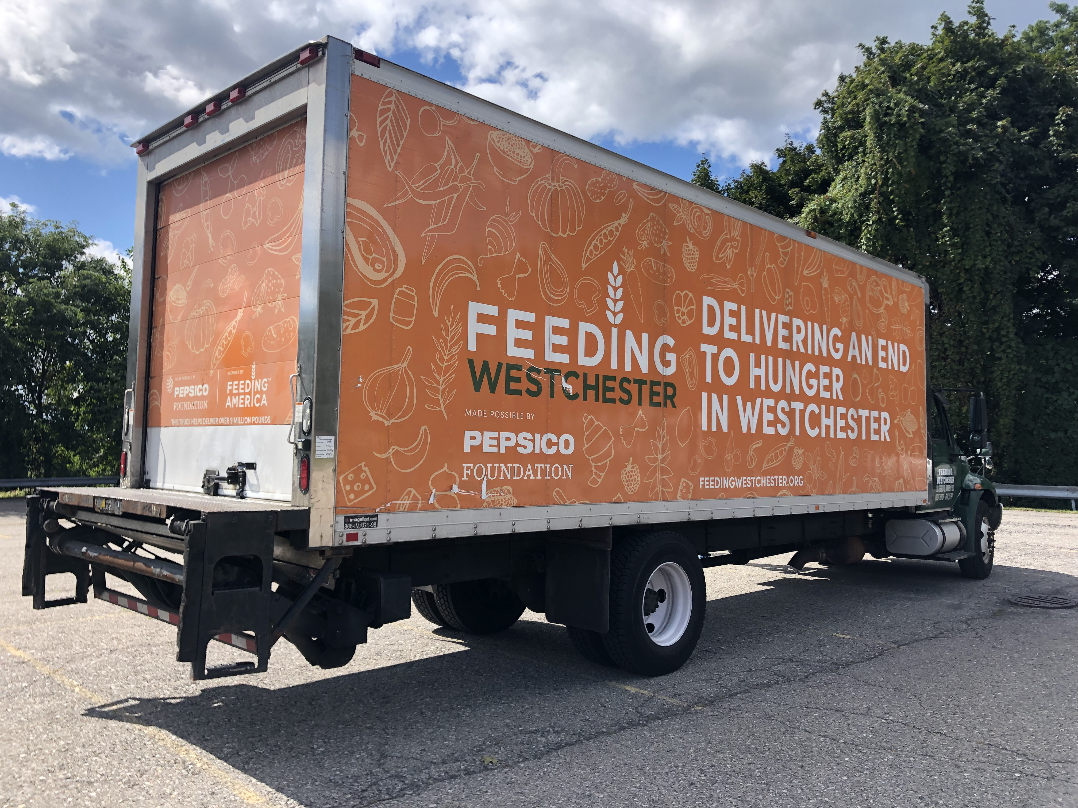
5. Transportation
Costs for the transportation of food from source to EFP site may be funded
  Payments to rent or lease vans
  Mileage reimbursement at up to $0.65 per mile
  Costs for delivering food from EFP site to pantry recipients are not fundable.
Notes:
Costs for the transportation of food from source to EFP site may be funded. This may include payments to rent or lease vans, (rent/lease option) or mileage reimbursement at up to $0.58 per mile for the mileage option. Costs for delivering food from EFP site to pantry recipients are not fundable.
If the vehicle rent/lease option is used, all records documenting this payment of funds to the renting agency are to be retained. Vehicles must be cargo-type vans or trucks; payments to EFP staff or volunteers for the use of personally-owned vehicles are not allowable. If the mileage option is used, an EFP staff or volunteer may be reimbursed for actual mileage incurred on personally-owened vehicles. A log showing dates, destination, and odometer readings is to be turned in to Feeding Westchester
Regardless of the method used, the EFP must retain records sufficient to prove that the transportation charged to the state was required to move food from source to the EFP site.

Slide 13
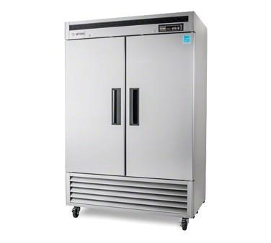
6. Food Service (Capital) Equipment*
EFP’s may request funding for new food service equipment items essential to their emergency food operations.
  Refrigerators
  Freezers
  Stoves/Stove Accessories (Hood)
  3-compartment sinks
  Hand Trucks
  Shelving
  Pallet Jacks
OS grants will not fund building alterations, wiring or plumbing work, or other installation charges.
* Equipment purchased with an OS grant are property of the New York State Department of Health
Notes:
An EFP may request funding for new food service equipment items essential to their emergency food operations. OS grants will not fund building alterations, wiring or plumbing work, or other installation charges.

Slide 14
Food Service – Capital Equipment Cont.
Agencies considering an appliance request must confirm the building where the equipment will be located has sufficient electrical capacity, plumbing capability, space, ventilation, and entry way clearance for the desired equipment. Agencies are responsible for installation and removal of all equipment (HPNAP will not cover this cost). All equipment awarded is property of NYS HPNAP. If your program closes you must notify Feeding Westchester immediately.
Funds for equipment grants are limited, so applicants should prioritize their needs and only request essential equipment. In rating the application, the review committee will consider the need for the equipment, the type and appropriateness of the equipment requested, and the cost for each item as well if the award will assist with increasing your capacity.
Refrigerators, Freezers, Stoves, 3 Compartment Sinks are ordered directly by Feeding Westchester from a designated vendor. All other equipment requests, such as hand trucks, shelving, etc… require the agency to provide 3 cost estimates from 3 different vendors.

Slide 15

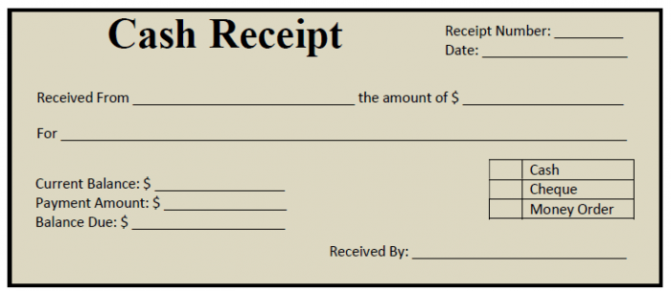

Staff Backup Documents
Time sheets
Payroll or Stipend Records
Cash receipts or Money Transfers
Cancelled checks
Copies of 1099 or W-2 forms
Notes:
Now I will go through the appropriate backup documents for each category. For staff, documents such as time sheets, payroll and stipend records, cash receipts or online money transfers, cancelled checks, copies of 1099 or w-2 forms. The documents must clearly prove that the grant award was paid to the direct services worker.

Slide 16
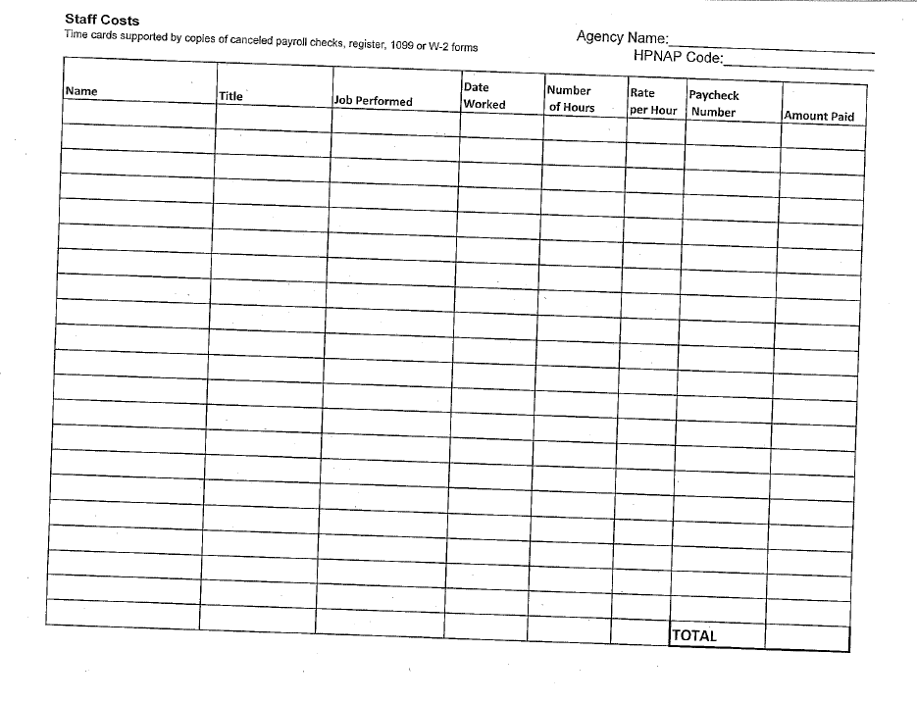
HPNAP Staff Cost Log
Notes:
In addition to these documents, we ask the agencies to log the backup documents on this form to total their expenditures for the entire grant period. The document asks for the Agency name and HPNAP number and details relating to the jobs and payments made for staffing.

Slide 17

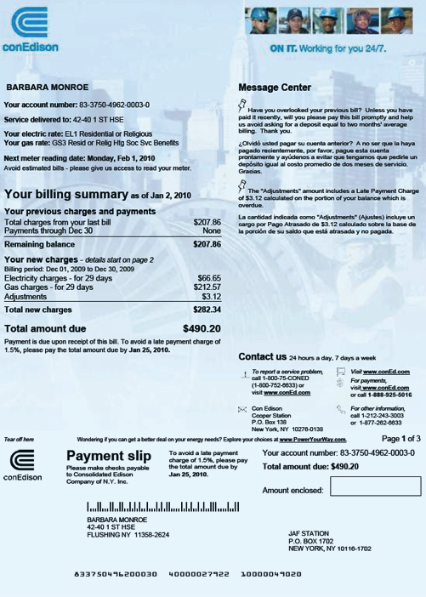

Utilities Backup Documents
Utility bills supported by copies of canceled checks verifying payment of bills
Notes:
Copies of utilities bills supported by copies of canceled checks verifying payment of the bills and an explanation of the percentage of utilities bills charged to the OS grant.

Slide 18
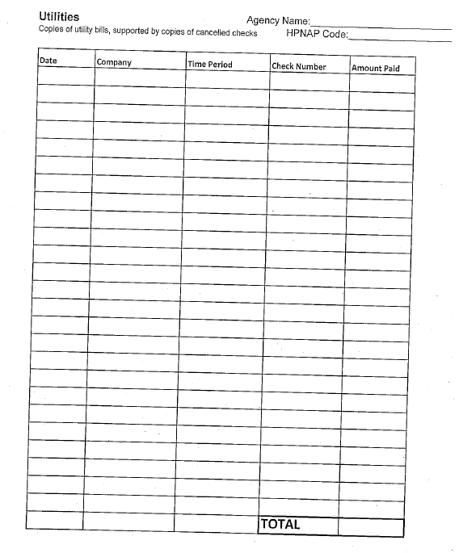
HPNAP Utilities Cost Log
Notes:
In addition, there is a HPNAP Utilities cost log that we ask the agencies to list their backup documents and calculate the total amount paid for the grant period.

Slide 19

Space Backup Documents
Copies of current rental/lease agreements supported by copies of canceled checks
Additional documentation such as floor plans may be requested
Notes:
For space costs, copies of current rental/lease agreements supported by copies of canceled checks are required. Additional documentation such as floor plans, percentage of space cost/use, and an explanation of the use of OS funds may also be requested.

Slide 20
HPNAP Space Cost Log
Notes:
Like staffing and utilities, we ask the agencies to utilized the Space Cost log to list their backup documents. In addition, we ask agencies to calculate the total amount of money that was spent on this category using this form.

Slide 21
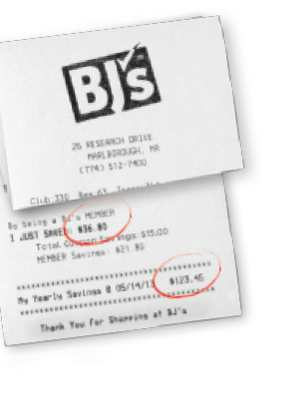
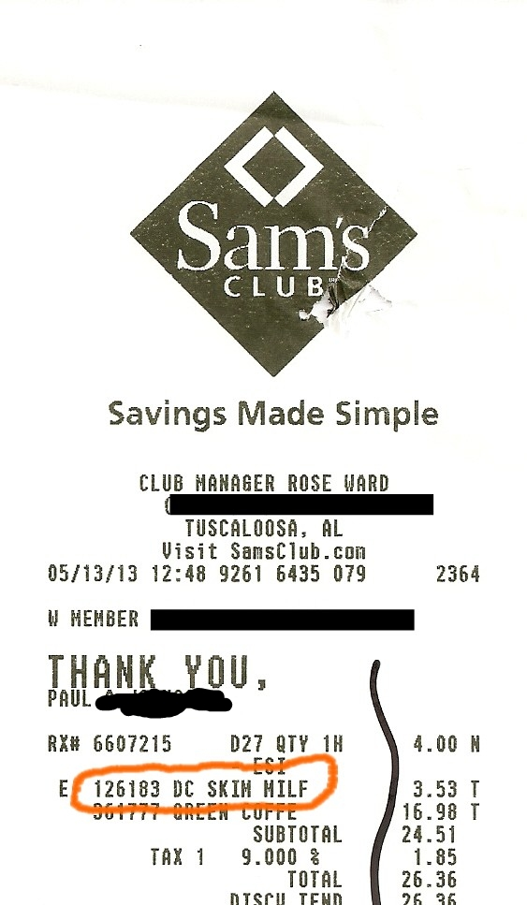

Disposables Backup Documents
Vendor invoices
Register receipts
Requests for durable items must be accompanied by written justification
Feeding Westchester Invoices with copy of canceled check
Notes:
Food Service Disposables and Other Supplies will require vendor invoices or register receipts identifying the items purchased. Items may be hand written on register tapes. Requests for durable items must be accompanied by written justification for items requested. Canceled checks supporting these purchased may also be required.

Slide 22
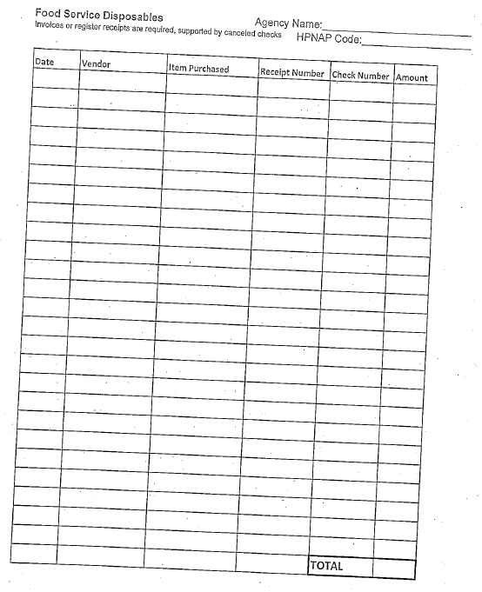
HPNAP Disposables Cost Log
Notes:
The HPNAP Disposables cost log should also be used to document disposables expenditures. This form should be used to calculate the total amount of money that was spent on this category.

Slide 23
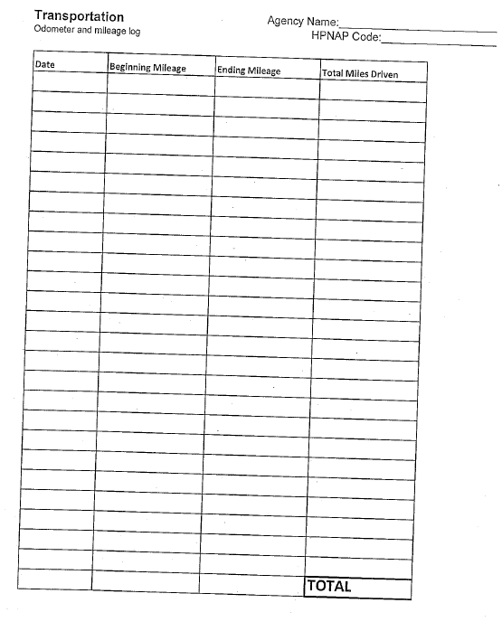
Transportation Backup Documents
Log showing dates, destinations, odometer readings and mileage traveled
  This log must be signed by the individual submitting the cost (driver) and endorsed by the agency supervisor
Notes:
For Transportation, the backup documentation would include the HPNAP Transportation Cost log that shows the dates, destinations, odometer readings and mileage traveled. This log must be signed by the individual submitting the cost and endorsed by the agency supervisor or coordinator authorizing the expenditures.

Slide 24
Expenditure Timeline
  Expenditures can take place from July 1, 2024 – June 30, 2025
  Expenditures should show 100% of each categorical allocation has been spent
  Any funds that are not spent or not documented, must be returned to Feeding Westchester

Slide 25

When Is Backup Due?
How Do I Submit My Backup?
DUE DATE for BACKUP:
Suggested Due Date by Monday May 1, 2025 by 5PM
SUBMIT Using Electronic Link for HPNAP Support FY25
Monique McCoy, Manager, Agency Relations – Agencies A - L
EMAIL: mmccoy@feedingwestchester.org
Wini Bonamico, Manager, Agency Relations – Agencies M - Z
EMAIL: wbonamico@feedingwestchester.org
MAIL:
Feeding Westchester
200 Clearbrook Road
Elmsford, NY 10523

Slide 26

Importance of Submitting Backup
ON TIME
Feeding Westchester must obtain backup records from EFPs to report to HPNAP
Failure to submit backup on time jeopardizes Feeding Westchester the ability to acquire grant funding from HPNAP
Agencies may not receive HPNAP OS in the following grant year if backup is submitted late or if backup does not prove full expenditure of the grant award
Please be organized with your documentation for expenditures. If you are awarded $1000 for Utilities, you may submit expenditures up to that amount for the time frame awarded. For example, there is no need to submit all your utility bills for the year.

Slide 27
Review Sample HPNAP FY25 Application
Agencies will be provided with a PDF form of the HPNAP FY25 Application to use ONLY as a GUIDE as you complete the online version.
No handwritten copies will be accepted.
Any question with a red asterisk is required. We ask that you be thorough in all applicable questions. Please pay close attention to any questions that require a detailed answer for which you will be assessed, and points earned. Please do not answer without detail. For example program uniqueness and impact, grant impact, etc.
Please make sure your application is thoroughly completed. Feeding Westchester does not spot check applications as they are received.
Please Note: Applications will be received by Feeding Westchester when you submit electronically.

Slide 28
Questions?
Monique McCoy/Wini Bonamico; Food and Operations Support - Agency Relations
mmccoy@feedingwestchester.org
wbonamico@feedingwestchester.org
Monique Marshall - Nutrition Resource Manager – Green Thumb Program
mmarshall@feedingwestchester.org

